Slide 1
AI4ALL SFU ITF 2021
Types of Machine Learning Algorithms
Notes:
Images do not belong to A4ALL, all images taken from Google Search.

Slide 2
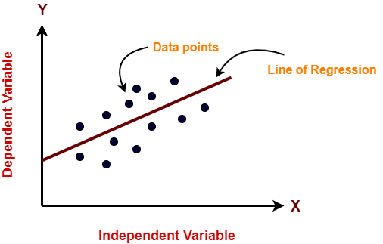
Linear Regression
Used to model the relationship b/w two variables (X and Y) by fitting a linear equation to the observed data.

Slide 3
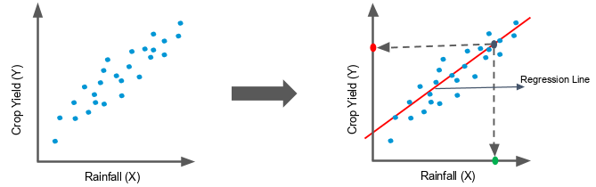
Linear Regression
Example: Predicting crop yields from the amount of rainfall
Here the crop yield is the dependent variable (Y) which depends on the amount of rainfall (X)

Slide 4
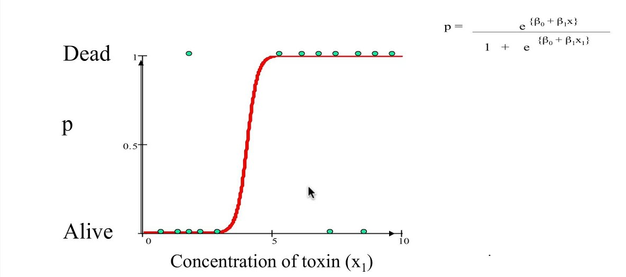
Logistic Regression
Using a logistic function (S-shaped curve) to model a binary dependent variable (“binary” means that there are 2 possible values for the variable).
Notes:
The logistic function looks like a big S and will transform any value into the range 0 to 1. This is useful because we can apply a rule to the output of the logistic function to snap values to 0 or 1 (e.g. If the output is less than 0.5 then just make output equal to 0) and predict a class value. This is why logistic regression is often used for binary classification problems (binary means there are 2 classes).
The predictions made by logistic regression can also be used as the probability of a given data instance belonging to class 0 or class 1. This can be useful on problems where you need to give more rationale for a prediction.

Slide 5
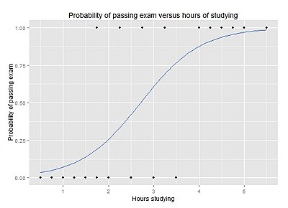
Logistic Regression
Example: Probability of Passing Exam vs. Hours Studied

Slide 6
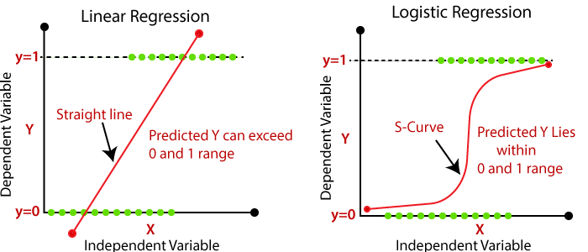

Slide 7
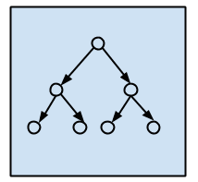
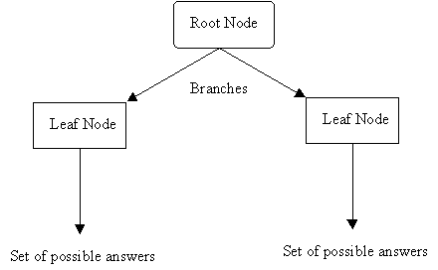
Decision Tree
Tree-like model of decisions used to go from observations about an item to conclusions about the item.
Supervised learning technique that can be used for classification and/or regression problems.

Slide 8
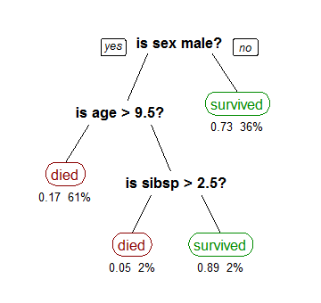
Decision Tree
Example: Using the Titanic dataset to classify whether a passenger would survive based on features like gender, age, # of family members.
Survival of Passengers on the Titanic
“sibsp” represents the # of spouses/children

Slide 9
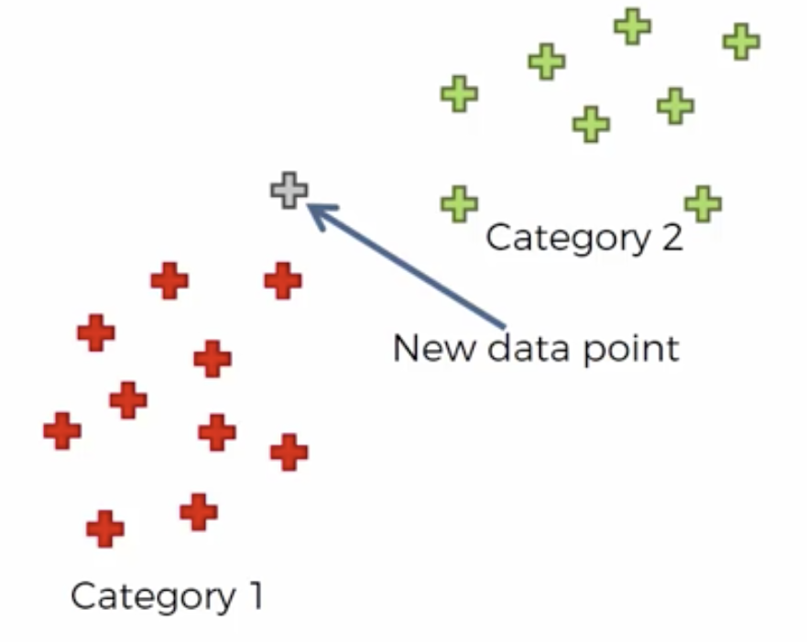
K-Nearest Neighbours
KNN assumes that similar things are near each other when graphed as data points.
KNN classifies a new data point based on similarity to other already-classified data points.
Supervised learning technique that can be used for classification and/or regression problems.

Slide 10
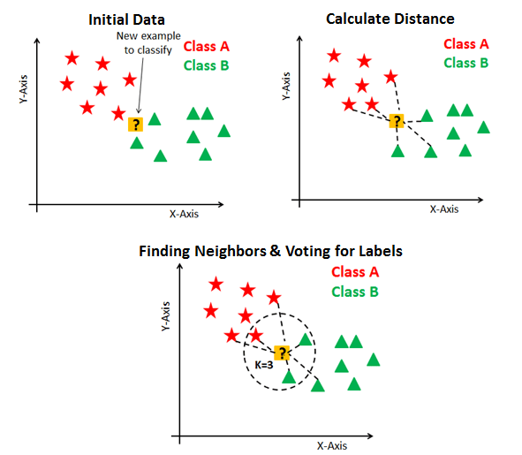
K-Nearest Neighbours
Based on K=3, the new data point would belong to Class B!

Slide 11
Naive Bayes
Algorithm based on the Bayes theorem of probability, “naively” assumes that data features are independent of one another.
Used for classification problems.
Used for spam filtering, and text-based (NLP-Natural Language Processing) applications.
Notes:
Naive Bayes algorithm relies on assumption that data features are independent to each other. For instance if you take features like temperature, humidity and wind speed to predict the rain you would assume that all those three features independently contribute to probability of upcoming rain.
Even if these features are somewhat related, we would naively say they aren’t. This is one of reasons why algorithm is called ‘Naive’.

Slide 12
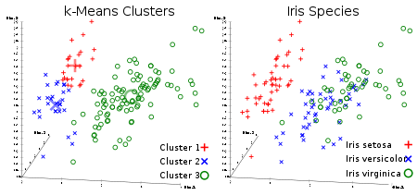

K-means Clustering
Unsupervised learning technique used to group similar data points into K “clusters” (where K is a positive integer).

